Slide 1
Transformations and Actions

Slide 2
Transformations
Actions
What is Pair RDDs
Creating Pair RDDs
Persisting RDDs
Storage Level
Accumulators
Broadcast Variables

Slide 3
Actions
Actions return values to the driver program.
Common actions are:
reduce(func)
collect()
count()
first()
take(n)
foreach(println)
saveAsTextFile(path)
Action
RDD
Value
Notes:
Notes:
reduce(func): Aggregate the elements of the dataset using a function func (which takes two arguments and returns one). The function should be commutative and associative so that it can be computed correctly in parallel.
collect(): Return all the elements of the dataset as an array at the driver program.
count(): Return the number of elements in the dataset.
first(): Return the first element of the dataset (similar to take(1)).
take(n): Return an array with the first n elements of the dataset.
saveAsTextFile(path): Write the elements of the dataset as a text file (or set of text files).
foreach(func): Run a function func on each element of the dataset.

Slide 4
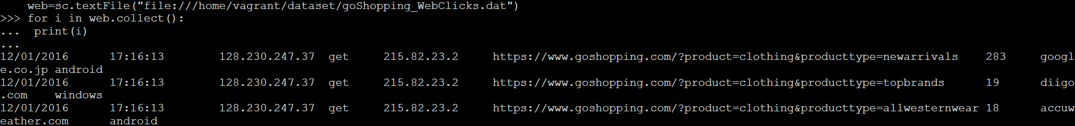
Actions – Collect()
Objective: Display the records of goShopping_WebClicks.dat file.
Action:
Output:
web=sc.textFile("file:///home/vagrant/dataset/goShopping_WebClicks.dat")
for i in web.collect():
print(i)

Slide 5
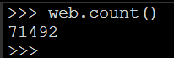
Actions – Count()
Objective: Count the number of records of goShopping_WebClicks.dat file.
Action:
Output:
web=sc.textFile("file:///home/vagrant/dataset/goShopping_WebClicks.dat")
web.count()

Slide 6
Actions – take(n)
Objective: Display first 2 records of goShopping_WebClicks.dat file.
Action:
Output:
web=sc.textFile("file:///home/vagrant/dataset/goShopping_WebClicks.dat")
for i in web.take(2):
print(i)

Slide 7
Transformations
Creating a new RDD from an existing RDD.
Common transformations are:
map(func)
filter(func)
flatMap(func)
inputRDD:
List("hello world", "hello")
map(line => line.split(" "))
flatMap(line => line.split(" "))
inputRDD: {1,2,3,4}
filter(x => x!=1)
Notes:
Notes:
map(func) : Return a new distributed dataset formed by passing each element of the source through a function func.
filter(func) : Return a new dataset formed by selecting those elements of the source on which func returns true.
flatMap(func): Similar to map, but each input item can be mapped to 0 or more output items (so func should return a Seq rather than a single item).

Slide 8
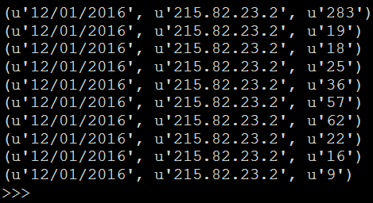
Transformations – map(func)
Objective: Retrieve date, customer ip, time spent on shopping site .
Action:
Output:
web=sc.textFile("file:///home/vagrant/dataset/goShopping_WebClicks.dat")
fields=web.map(lambda x:x.split("\t"))
rdd=fields.map(lambda x:(x[0],x[4],x[6]))
for i in rdd.take(10):
print(i)

Slide 9
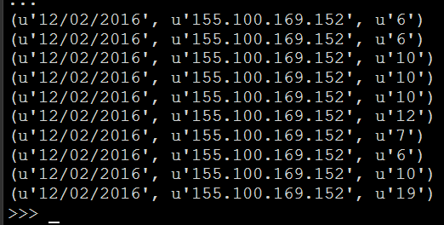
Transformations – filter(func)
Objective: Retrieve date, customer ip, time spent on shopping site only on "12/01/2016"
Action:
web=sc.textFile("file:///home/vagrant/dataset/goShopping_WebClicks.dat")
fields=web.map(lambda x:x.split("\t"))
filtered=fields.filter(lambda x:x[0]=="12/02/2016")
rdd_result=filtered.map(lambda x:(x[0],x[4],x[6]))
for i in rdd_result.take(10):
print(i)
Output:

Slide 10
Lazy Evaluation
Sample.txt
All transformations are lazy, in that they do not compute their results until an action is called.
Welcome to spark course.
Spark and Scala.
Spark Programming.
rdd
rdd=sc.textFile("file:///home/vagrant/dataset/WordCount_Sample.txt")
rdd_uc=rdd.map(lambda x:x.upper())
for i in rdd_uc.collect():
print(i)
RDD: rdd
Welcome to spark course.
Spark and Scala.
Spark Programming.
rdd.
RDD: rdd_uc
WELCOME TO SPARK COURSE.
SPARK AND SCALA.
SPARK PROGRAMMING
RDD

Slide 11
Lazy Evaluation
RDD Lineage and toDebugString():
Spark maintains each RDDs lineage i.e. previous RDD which it depends.
When an RDD is created, it just holds metadata.
A transformation that created the RDD.
Its parent RDD from which it was created.
Example:
RDD 1
Load Data
sample.csv
RDD2 contains meta data that was created by transformation on RDD1
RDD 2

Slide 12
What is Pair RDDs?
Special form of RDD.
Each element in an Pair RDD is a key-value pair.
Key-value can be of any type.
Common Pair RDDs are:
groupByKey([numTasks])
reduceByKey(func, [numTasks]):
Pair RDDs are useful:
sorting, grouping, etc..
Pair RDD
(key, value)
(key, value)
(key, value)
Notes:
groupByKey([numTasks]): When called on a dataset of (K, V) pairs, returns a dataset of (K, Iterable<V>) pairs.
reduceByKey(func, [numTasks]): When called on a dataset of (K, V) pairs, returns a dataset of (K, V) pairs where the values for each key are aggregated using the given reduce function func, which must be of type (V,V) => V.

Slide 13
Creating Pair RDDs
To create Pair RDDs:
get data in the form of key, value pair.
Commonly used functions to create Pair RDDs:
groupByKey
reduceByKey

Slide 14
Pair RDDs – groupByKey([numTasks])
Objective: Display the list of IP addresses for each country .
Action:
Output:
rdd=sc.textFile("file:///home/vagrant/dataset/goShopping_IpLookup.txt")
fields=rdd.map(lambda x:x.split(","))
rdd=fields.map(lambda x:(x[1],x[0]))
grped_rdd=rdd.groupByKey().mapValues(list)
for i in grped_rdd.take(10):
print(i)

Slide 15
Pair RDDs – groupByKey([numTasks])
field(1) - country
field(0) - IP
groupByKey
goShopping_IpLookup.txt
(UK, 172.189.252.8)
(IND, 8.37.71.25)
(USA, 128.230.122.180)
(UK,215.82.23.2)
(UK, 172.189.252.8, 215.82.23.2)
(IND, 8.37.71.25)
(USA, 128.230.122.180)

Slide 16
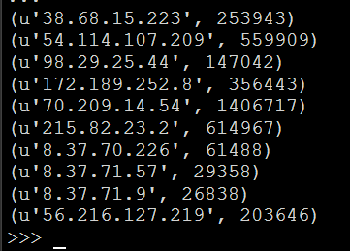
Pair RDDs – reduceByKey(func, [numTasks])
Objective: Find total time spent on shopping site by each customer.
Action:
Output:
web=sc.textFile("file:///home/vagrant/dataset/goShopping_WebClicks.dat")
fields=web.map(lambda x:x.split("\t"))
rdd=fields.map(lambda x:(x[4],int(x[6])))
result=rdd.reduceByKey(lambda x,y:x+y)
for i in result.take(10):
print(i)

Slide 17
Pair RDDs – reduceByKey(func, [numTasks])
(8.37.71.91, 180)
……
(8.37.71.91, 60)
………
(8.37.71.91, 257)
……….
(8.37.71.91, 240)
(8.37.71.91, 497)
(8.37.71.91, 497)
……
…….
…….
…….
…….

Slide 18
Persisting RDDs
One of the important features of Spark is is persisting (or caching) a dataset in memory across operations.
Persisting an RDD:
each node stores any partitions of it that it computes in memory and reuses them in other actions on that dataset.
allows future actions to be much faster.
use persist() or cache() methods.
The difference between cache() and persist():
cache() == default storage level (MEMORY_ONLY).
persist() == specify various storage levels.

Slide 19
Storage Levels
Storage Level | Meaning
MEMORY_ONLY | Default level. Store RDD as deserialized Java objects in the JVM
MEMORY_AND_DISK | Store RDD as deserialized Java objects in the JVM. If the RDD does not fit in memory, store the partitions that don't fit on disk, and read them from there when they're needed.
DISK_ONLY | Store the RDD partitions only on disk.

Slide 20
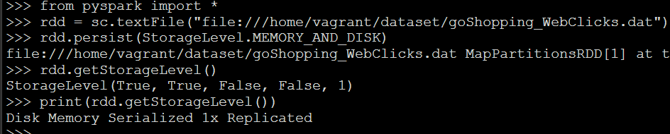
Persisting RDDs - Example
from pyspark import *
rdd = sc.textFile("file:///home/vagrant/dataset/goShopping_WebClicks.dat")
rdd.persist(StorageLevel.MEMORY_AND_DISK)
rdd.getStorageLevel()
print(rdd.getStorageLevel())
Output:

Slide 21
Accumulators
Accumulators:
Variables that are used for aggregating information across the executors.
Simple syntax for aggregating values from worker nodes back to the driver program.
Use Case:
Find out the number of blank logs (blank lines) .
Number of times the network failed.
Number of times zero sales were recorded.

Slide 22
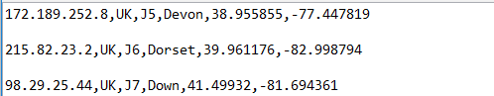
Accumulators
Objective: Find the number of blank lines present in "goShopping_IpLookup.txt" .
Input Data: "goShopping_IpLookup.txt"
Number of blank lines: 2

Slide 23
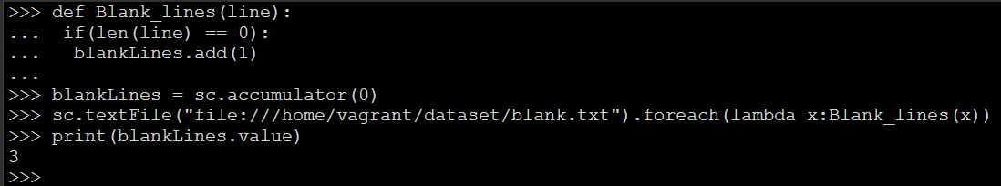
Accumulators
Using Accumulator variables:
Action:
Output:
def Blank_lines(line):
if(len(line) == 0):
blankLines.add(1)
blankLines = sc.accumulator(0)
sc.textFile("file:///home/vagrant/dataset/blank.txt").foreach(lambda x:Blank_lines(x))
print(blankLines.value)

Slide 24
Broadcast Variables
Broadcast Variables:
To keep a read-only variable cached on each machine rather than shipping a copy of it with tasks.
Use SparkContext.broadcast(v) to create broadcast variable.
Variable v acts as a broadcast variable.
value() can be used to access the broadcast variable.
Useful when tasks across multiple stages need the same data.

Slide 25
Broadcast Variables
Objective:
Categorize the user IP as type "AccidentVisit" if time spent is less than 60 secs , else as type " PurposeVisit "
Input File:
goShopping_WebClicks.dat

Slide 26
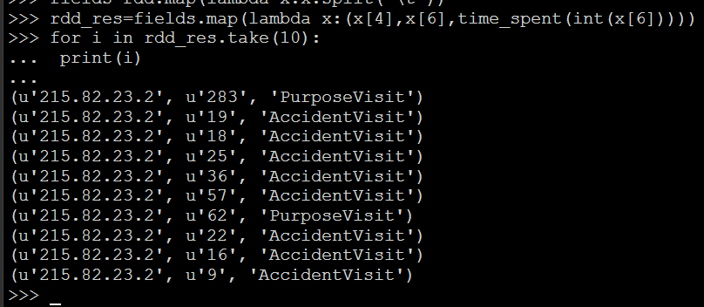
Broadcast Variables
Output:
def time_spent(x):
if( x < 60):
return accVisit.value
else:
return purVisit.value
accVisit = sc.broadcast("AccidentVisit")
purVisit = sc.broadcast("PurposeVisit")
rdd = sc.textFile("file:///home/vagrant/dataset/goShopping_WebClicks.dat")
fields=rdd.map(lambda x:x.split("\t"))
rdd_res=fields.map(lambda x:(x[4],x[6],time_spent(int(x[6]))))
for i in rdd_res.take(10):
print(i)

Slide 27
Broadcast Variables
worker
Executor
accVisit
purVisit
Task
accVisit , purVisit
Spark Application (DRIVER)
worker
val accVisit = sc.broadcast("AccidentVisit")
val purVisit = sc.broadcast("PurposeVisit")
Executor
accVisit , purVisit
worker
accVisit
purVisit
Executor
Task

Slide 28
Questions
Notes:
Application Delivery Fundamentals (ADF) 2.0: Testing
Module 02: Introduction to Software Development Life Cycle (SDLC)

Slide 29
Thank You

